Slide 1
Digital Signal Processing UG2
Digital Audio Representation PCM/WAV
By Yonghao Wang

Slide 2
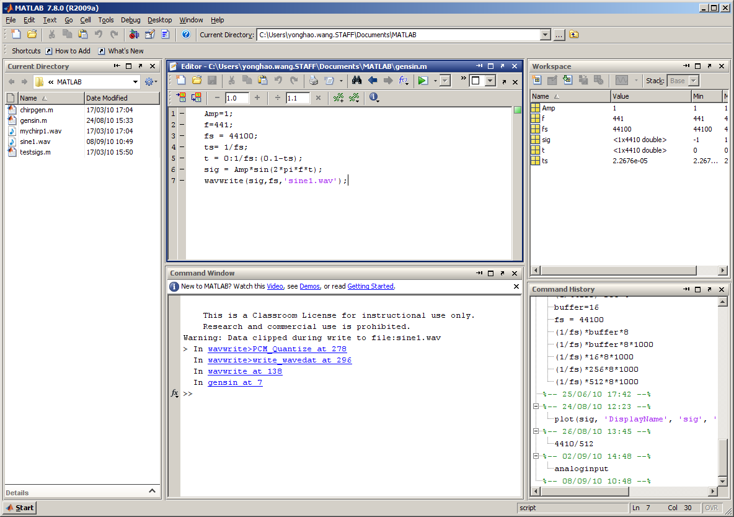
Matlab Lab Review

Slide 3
Variables
A = 3; %assign value ‘3’ into variable A
name = 'Peter'; %assign array 'Peter' to <name>
name(1) = P
…
name(5) = r
name(6)
??? Attempted to access name(6);

Slide 4
arithmetic operators
+, -, *, / and ^
a = 1:10
b = 10:-1:1
c = a+b
c = a*b %Wrong!!
??? Error using ==> mtimes
Inner matrix dimensions must agree.
c = a.*b; %correct way to multiply cell by cell.

Slide 5
Array manipulation
A = 1:5
A=
A = A’; % transpose symbol the ' (apostrophe) operator.
A =
1 | 2 | 3 | 4 | 5
1
2
3
4
5

Slide 6
Built-in functions
disp ( )
Example:
A=5;
disp(A);
plot(); stem();xlabel(); ylabel();
sin(); cos(); conv();
length(); abs(); max();
audioread(); audiowrite();

Slide 7
Plot function
x=a; y=b; % plot with default color and line style
figure(1);
plot(x,y,'*-r'); % red color and dash star style
title('test figure1');
xlabel('time');
ylabel('amplitude');
figure(2);
stem(x,y)

Slide 8
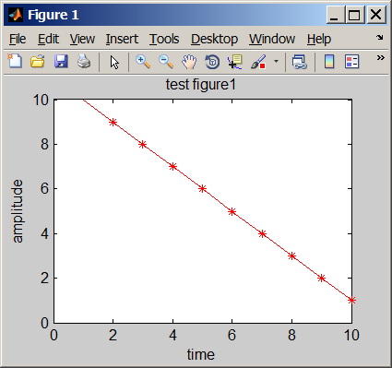
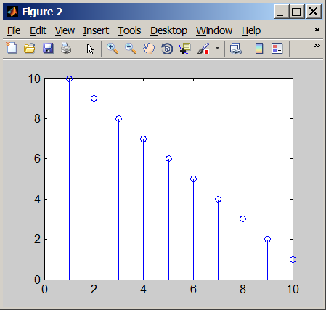

Slide 9
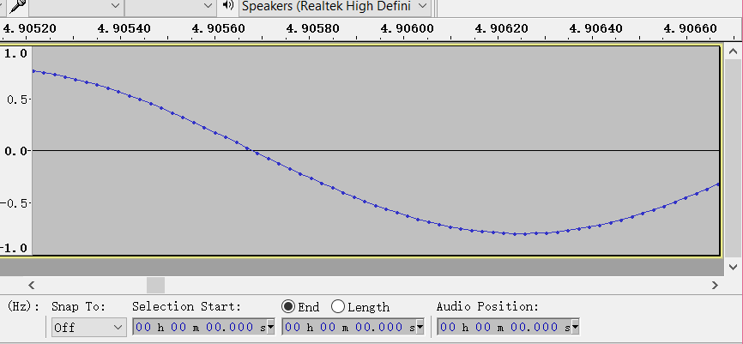
Audio Waveform in software
Waveform for note A 440HZ generated by @Audacity@

Slide 10
Pure tone
If the sound is a pure tone, the waveform will be a single-frequency sinusoidal wave.
This is very important because
There is a simple mathematic representation of pure sound (single frequency).
This provides a mathematical framework to synthesize the real instruments.

Slide 11
Review of digitisation
Signals be sampled at discrete points in time, each sample be quantized and encoded in binary (0s and 1s).

Slide 12
Pulse Code Modulation and Audio Digitization
Pulse Code Modulation (PCM) is common uncompressed digital format of audio.
PCM was first invented in 1937 by Alec Reeves for Telecommunication purpose.
PCM now becomes standard raw digital audio format for CD, and Digital Audio Tape (DAT) and DVD.
PCM files are digitised but NOT compressed audio format.

Slide 13
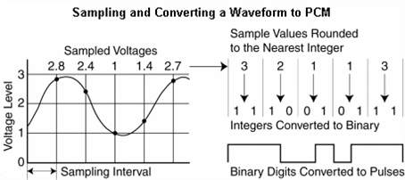
Sampling and PCM

Slide 14
Two important measurements - I
Sampling rate (Sampling frequency)
How many samples per second
The unit of sampling frequency is Hertz
Commonly used sampling frequencies
8000 Hz mono for telephone quality voice
44.1 kHz two-channel stereo with 16 bits per channel for CD-quality sound.
48 kHz for DAT
96 or 192 kHz for DVD audio

Slide 15
Two important measurements – II
Bit depth (resolution)
2 bit – 4 possible values
8 bit – 256 possible values
16 bit – 65536 possible values (CD quality)
Commonly used bit depth
CD – 16 bit per channel
DVD - 24 bit per channel
Pro audio internal – 32 bit per channel

Slide 16
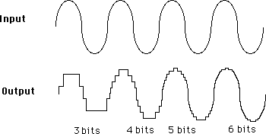
Effect of Resolution

Slide 17
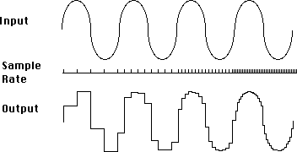
Effect of Sample Rate (Fs)

Slide 18
Audio Aliasing
Question: What if sampling rate is below Nyquist rate?
Answer: when you're digitizing an analog audio wave and your sampling rate is below the Nyquist rate, audio aliasing will occur. That is, when the digitised sound is played, the frequency from the original sound will be translated to a different frequency, so the digitized sound doesn’t sound exactly like the original.
Notes:
Let's look at how this happens, beginning with single-frequency waves, from which we can generalize to waves with more than one frequency component.

Slide 19
Example of Aliasing
A sound wave being sampled has a frequency of 637 Hz. This means that we need to sample it a Nyquist rate of at least 2*637=1274 samples/s – i.e., 1274 Hz.
Left diagram sampling rate at 1490Hz > 1274, hence no aliasing.
Notes:
More accurate mathematical definition of aliasing will be discussed in later sessions.

Slide 20
Example of Aliasing
For same 637 Hz signal, we sampled at 1000Hz the digitised signal will be aliased at 363 Hz. That means, aliasing will introduce the distortion of original signal.
Notes:
Dashed line represents original 637 Hz signal.
Black dot are sampled points.
Red line represents aliased signal 363 Hz.

Slide 21
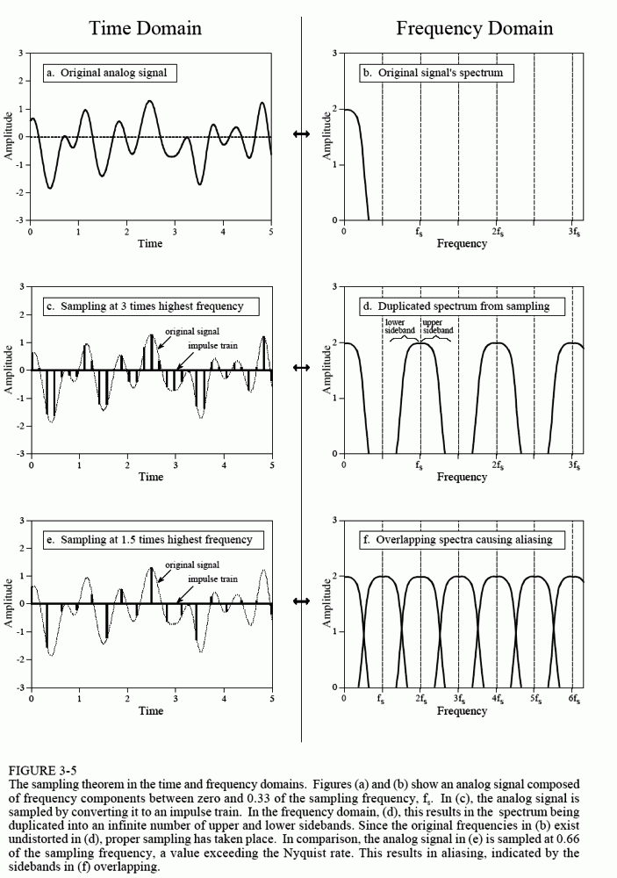
Aliasing in Frequency domain

Slide 22
Remember:
Sample in time-domain ⇒ repeat in frequency-domain
sample_{T}{x_{a}(t)} -> (1/T)repeat_{2π/T}{X_{a}(jω)}
( 2π/T is the sampling frequency in radians/second)

Slide 23
By this precise definition:
|X_{a}(jω)|
Given a spectrum
ω
-π/T
π/T
|REPEAT_{2π/T} {X_{a}(jω)}|
|X_{S}(jω)|
X_{a}(jω)
ω
-4π/T
-2π/T
-π/T
π/T
2π/T
4π/T

Slide 24
Sampling Rate and Aliasing
Nyquist theorem:
To guarantee accurate reconstruction of a sampled analogue signal, we must use a sampling rate that is greater than twice the frequency of the highest frequency component in the signal.
Notes:
Fs is sampling frequency;
Fmax is maximum frequency components of original signal.

Slide 25
Digital Audio Formats
Digital audio comes in many different formats.
Groups like MPEG have created open standards.
Even formats based on the same MPEG standard may not compatible with each other because of proprietary components.

Slide 26
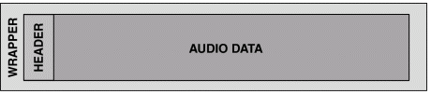
Digital Audio Files
An audio file has two main parts: a header and the audio data.
The header is used to store information about the file, including the resolution, sampling rate and type of compression.
A “wrapper” is used to add features, such as license management information or streaming capability, to a digital audio file.
Notes:
The actual Audio data can be encoded in different formats such as MPEG-1 Audio Layer III (MP3) or PCM (uncompressed raw data)

Slide 27
Common Digital Audio Formats
Type | Extensions | Codec
AIFF (Mac) | .aif, .aiff | *PCM
CD audio (CDDA) | N/A | PCM
WAV | .wav | *PCM
MP3 | .mp3 | MPEG1&2 Audio Layer-III
AAC | .m4a;.mp4; .3gp | MPEG2 Part 7; MPEG4 Part3
Windows Media Audio | .wma | Proprietary (Microsoft)
QuickTime | .qt | Proprietary (Apple Computer)
RealAudio | .ra, ram | Proprietary (Real Networks)
Other popular ones: OPUS, FLAC
File Containers: OGG, WEBM

Slide 28
WAV files
WAV file format may use different encodings (PCM, DPCM, ADPCM).
When you recording, editing, exporting audio files, you use PCM encoding.
[y,Fs] = audioread('filename')
y : raw samples
Fs : Sampling frequency
It does internally convert the fixed point wav file to float point audio data.
Notes:
Because wav file is default of windows machine.

Slide 29
Fixed-Point vs. Floating-Point
16-bit Fixed point: 65,536 possible bit patterns (2¹⁶) => 96dB dynamic range
Floating-point DSPs via a minimum of 32 bits using scientific notation
number is represented with a mantissa and an exponent (e.g., A x 2^{B}, 'A' is the mantissa and ‘B’ is the exponent), yielding up to 4,294,967,296 possible bit patterns (2³²). (1528 dB)
Notes:
https://www.analog.com/en/education/education-library/articles/fixed-point-vs-floating-point-dsp.html#
Size is not the possible patterns
https://chortle.ccsu.edu/java5/notes/chap11/ch11_2.html
float32 bits-3.4E+38 to +3.4E+38about 7 decimal digits
Dynamic Range
https://www.sounddevices.com/32-bit-float-files-explained/

Slide 30
Fix to float points conversion
CD /DVD/MD using integer format such as 16 bits and 24 bits audio format.
Audio processing software use IEEE Float point sometimes double precision point.
Matlab audioread() function can import the native format.
You can convert audio format by scaling.

Slide 31
FFMPEG
LAME Bitrate Overview
lame option | Average kbit/s | Bitrate range kbit/s | ffmpeg option
-b 320 | 320 | 320 CBR (non VBR) example | -b:a 320k (NB this is 32KB/s, or its max)
-V 0 | 245 | 220-260 | -q:a 0 (NB this is VBR from 22 to 26 KB/s)
-V 1 | 225 | 190-250 | -q:a 1
-V 2 | 190 | 170-210 | -q:a 2
-V 3 | 175 | 150-195 | -q:a 3
-V 4 | 165 | 140-185 | -q:a 4
-V 5 | 130 | 120-150 | -q:a 5
-V 6 | 115 | 100-130 | -q:a 6
-V 7 | 100 | 80-120 | -q:a 7
-V 8 | 85 | 70-105 | -q:a 8
-V 9 | 65 | 45-85 | -q:a 9
Notes:
https://trac.ffmpeg.org/wiki/Encode/MP3
ffmpeg -i input.wav -codec:a libmp3lame -qscale:a 2 output.mp3

Slide 32
Practice
Compare the spectrum between WAV and MP3.
Using FFMPEG to compress online audio into MP4 or MP3 (youtube-dl with FFMPEG).
Notes:
https://youtu.be/hKRUPYrAQoE
Youtube-dl
https://ytdl-org.github.io/youtube-dl/index.html
Check format
youtube-dl -F https://youtu.be/hKRUPYrAQoE
Actual download
youtube-dl -f 22 https://youtu.be/hKRUPYrAQoE
Audio only
youtube-dl --extract-audio --audio-format mp3 https://youtu.be/hKRUPYrAQoE

